Slide 1
Domestic Electricity Bill Monitoring
Group-47
D GIRISH(2011188)
DEEPAK KUMAR(2011190)
K AVINASH REDDY(2011251)
KAMATHAM SRINADH(2011197)
VELURU JAYAVANTH REDDY(2011233)

Slide 2
Problem Specification
To Generate Electricity Bill, Person must go door to door which delays the process and requires more man power.

Slide 3
Concepts Generated

Slide 4
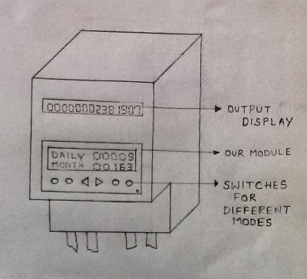
Concept-1
In this concept, we have to change the design of the meter.
There are two displays in this meter, one the default display and the other show the daily updates, monthly updates, cost per unit etc. in different modes.
To change these modes buttons are provided below the second display.
These buttons are designed in such a way that they are easy to navigate.

Slide 5
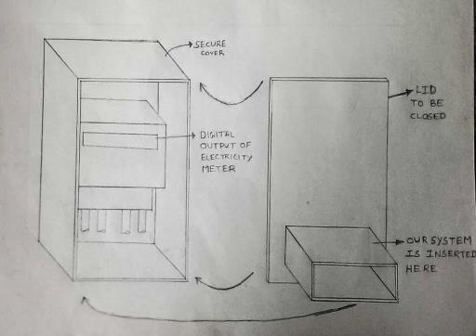
Concept-2
In this concept, the design of the meter is not changed.
A separate unit with its own display is connected to the present day meter.
This unit takes input from the meter and calculates the no of unit consumed per day and also keeps track of the no of units consumed in that month.
These two components are enclosed in a box for extra protection in bad weather conditions in villages.

Slide 6
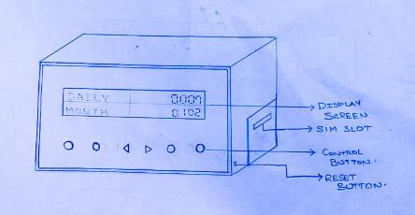
Concept-3
In this design, a portable device is made to communicate with the meter either wired/wireless.
This displays the updates and can remotely fixed anywhere in the house.

Slide 7
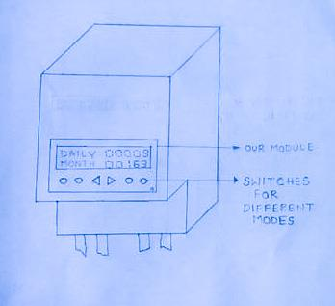
Concept-4
In this concept only one display is provided which shows the updates. This makes it easier for manufacturing and also easy for the user to see the details.

Slide 8
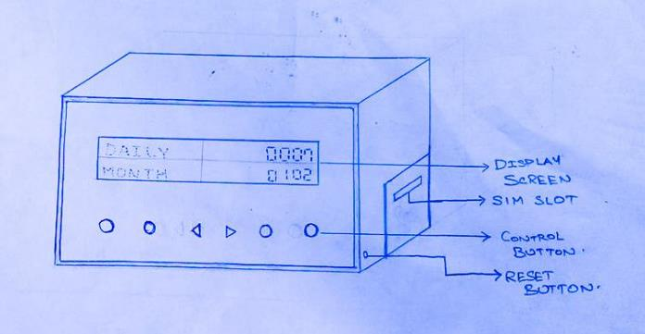
Final Concept

Slide 9
CAD Model of Final Design

Slide 10
Detailed Design
Components | Units | Type
Digital Energy Meter | 1 | Digital
GSM Module | 1 | SIM300
Max232 IC | 1 | -
Li-ion Battery | 1 | DC
16X2 Display | 1 | LCD
Capacitors | - | Ceramics
Resistors | - | -
Box | 1 | GI Sheet
Screws | - | Steel
Wall fixtures | 1 | GI Sheet
Box fixtures | 1 | GI Sheet

Slide 11
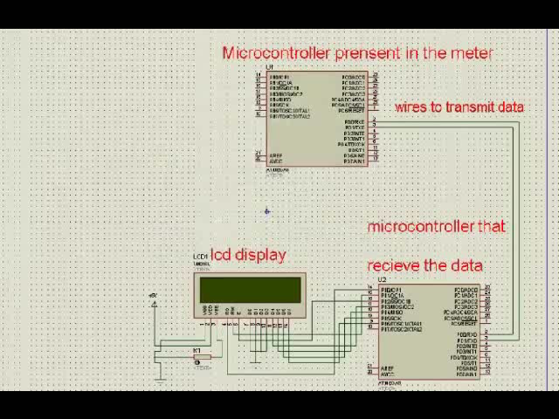
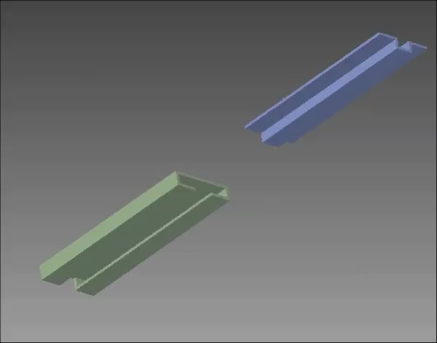
Model Simulation

Slide 12
Prototype Photographs

Slide 13
Thank you…!

